Slide 1

Federated GNNs Learning from Dynamic Graphs for Traffic Forecasting.
Muhammad Usman

Slide 2

Objectives
Outcomes
Motivation [problem]
Data Source
Methodology
Preliminary Analysis
Roadmap – Further Plaining
Real Time application Design

Slide 3
Problem [ Motivation ]
Advanced forecasting of traffic speed at different intersections in different cities within a country. Using Federated GNN Learning
Why it is important?
Emergency Response Planning
Traffic Management Optimization
Efficient Resource Utilization
Smart City Development
Economic Benefits

Slide 4
Data Sources
METR_LA
PEMS_Bay
PEMS_D7M
EXPY-TKY

Slide 5
More about First two datasets
Metr_LA : A traffic forecasting dataset based on Los Angeles metropolitan traffic conditions. The dataset contains traffic readings collected from 207 loop detectors on highways in Los Angeles county in aggregated 5-minute intervals for 4 months between March 2012 to June 2012.
PEMS-BAY: This traffic dataset is collected by California transportation agencies (Caltrans) performance measurement system (PEMS). It is represented by a network of 325 traffic sensors in the bay area with 6 months of traffic readings ranging from Jan 1st 2017 to may 31th 2017 in 5 minute intervals.

Slide 6

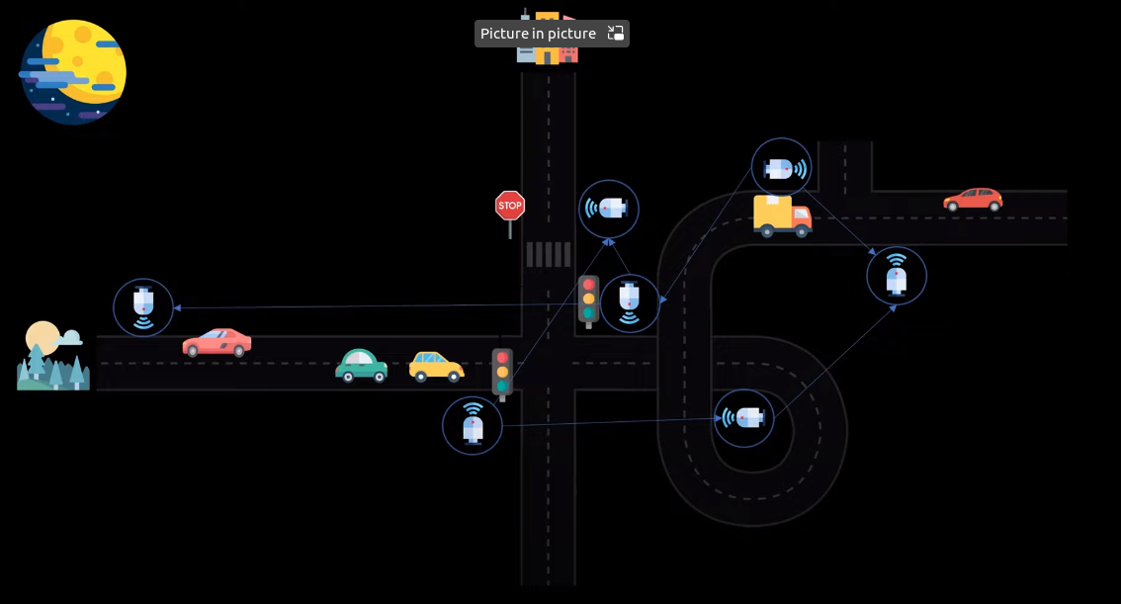
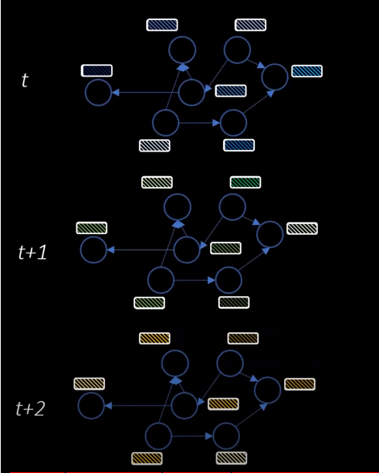
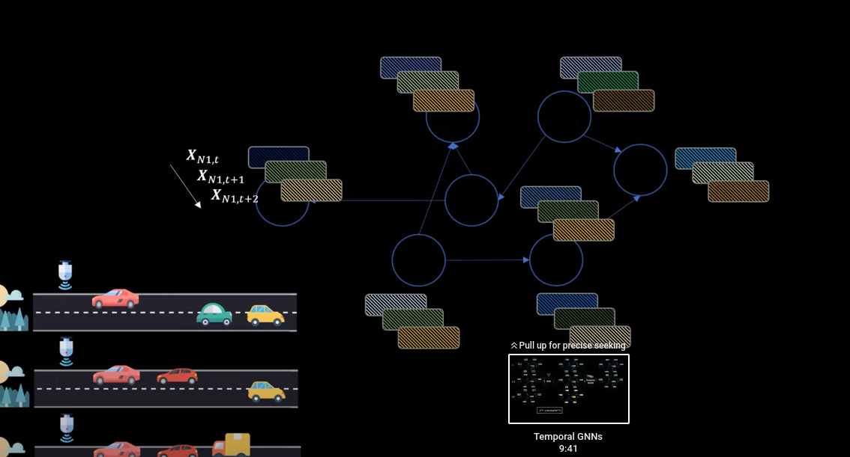
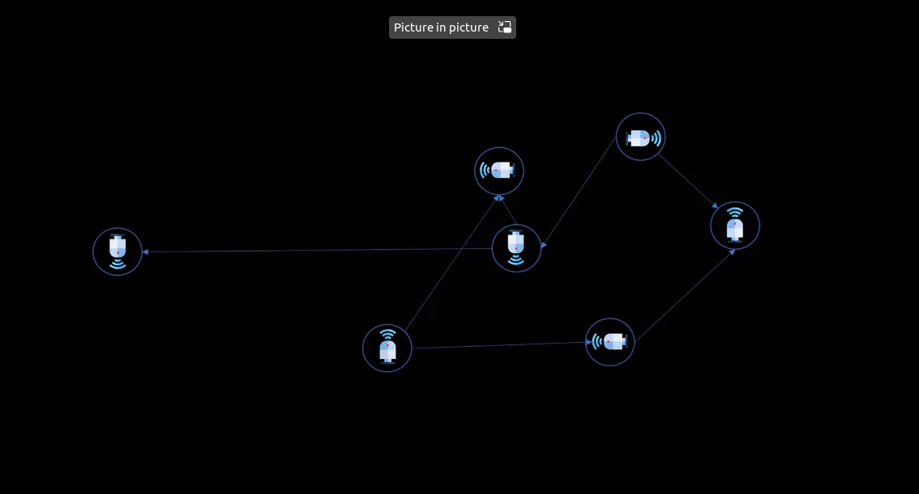
How the Metr_LA Dataset is constructed.

Slide 7

Federated GNNs Learning

Slide 8
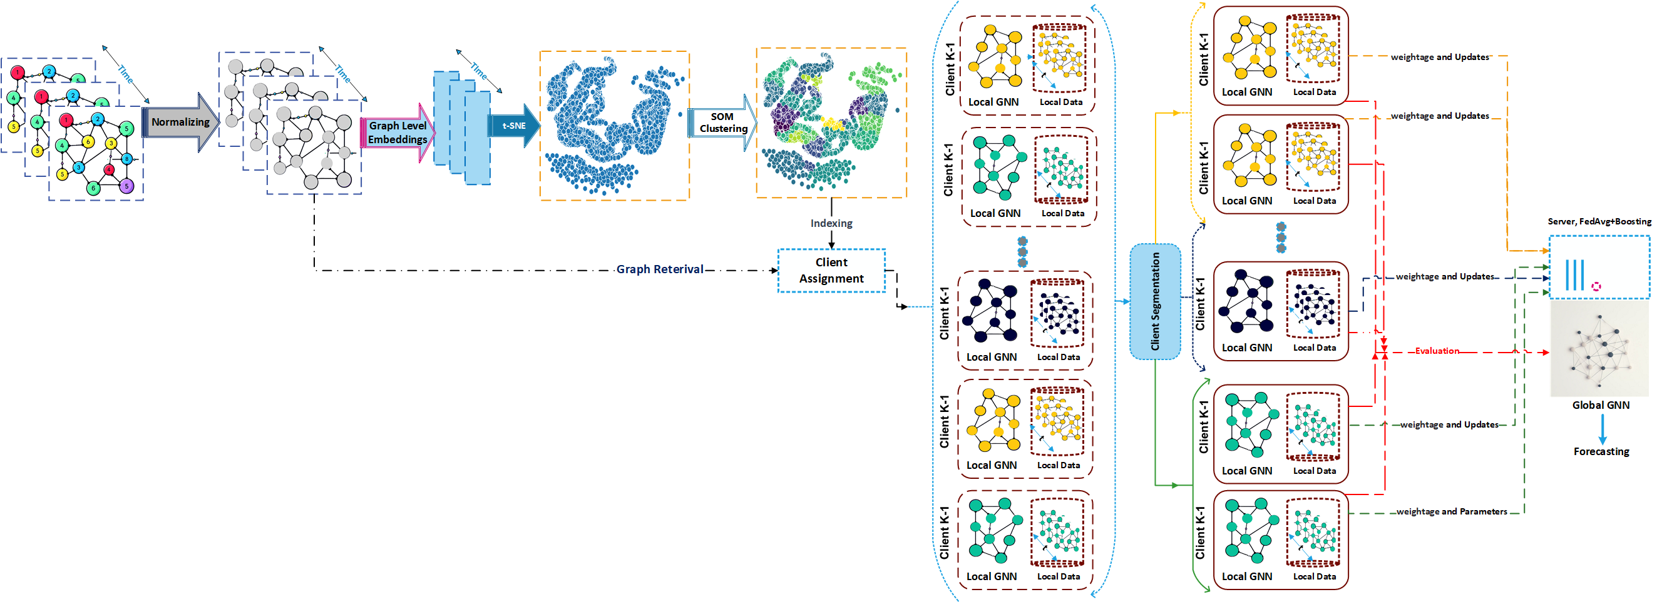
The Methodologies

Slide 9
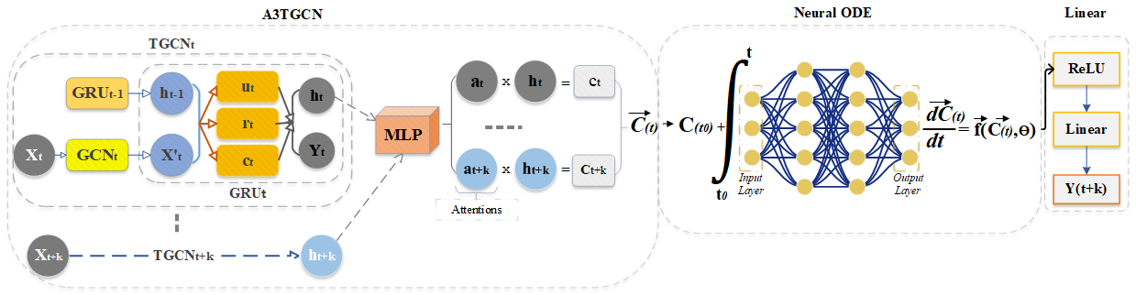
Participant’s Local algorithm(DFDG)

Slide 10
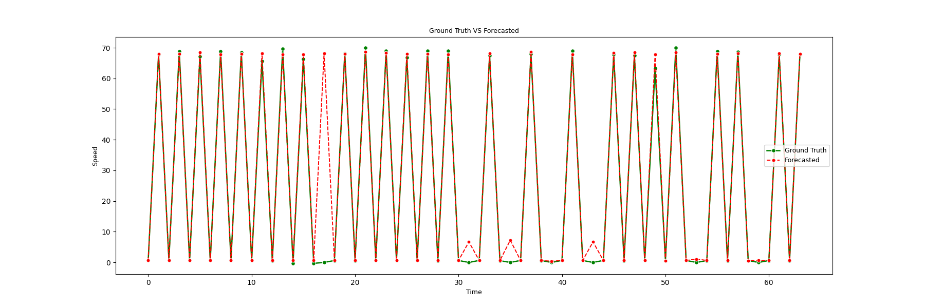
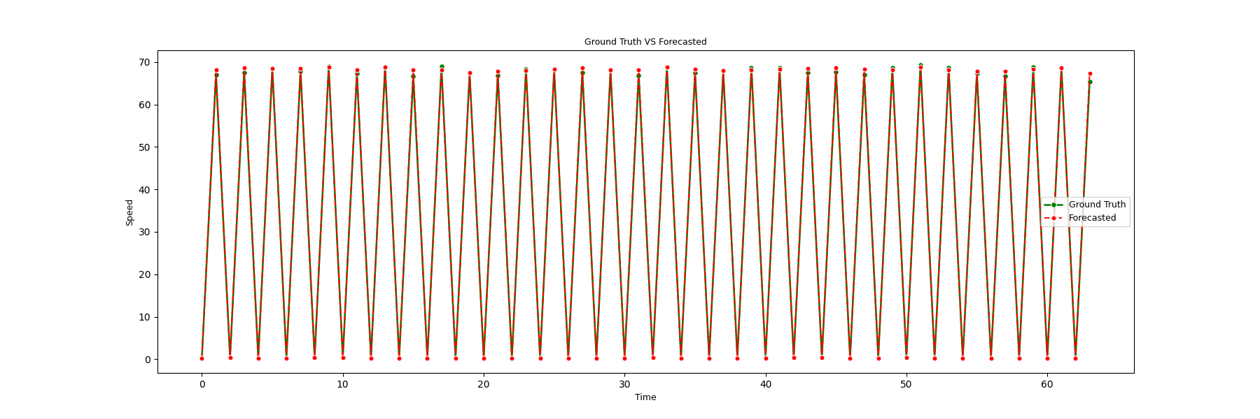
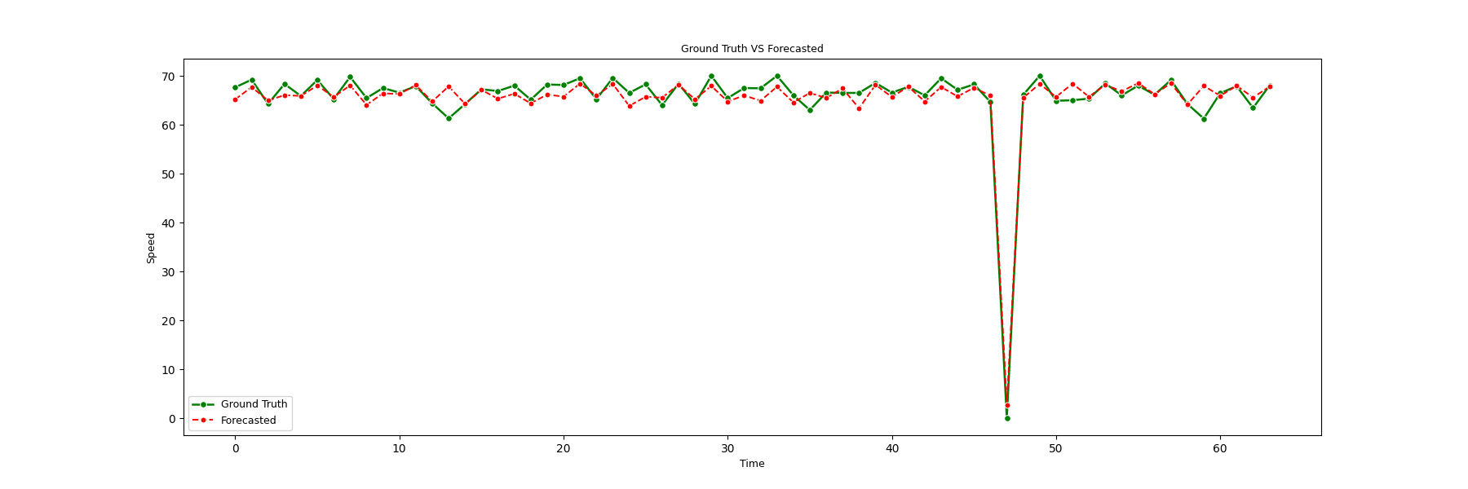
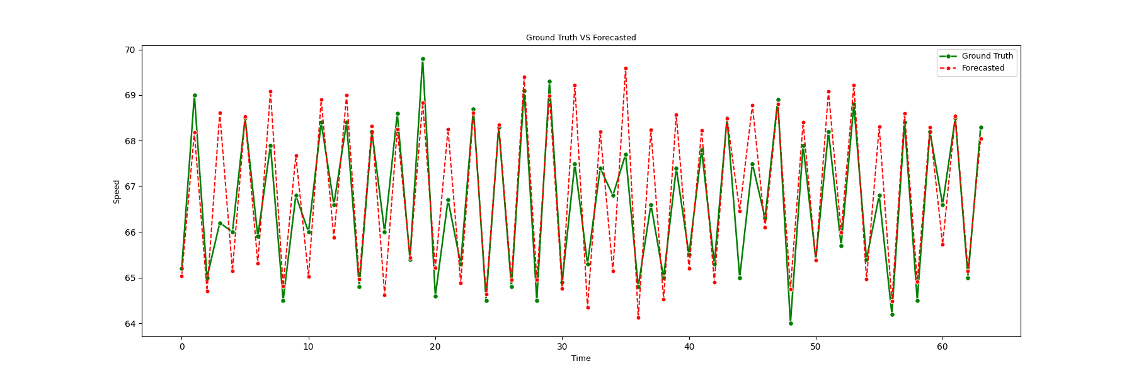
Forecasted Results
METR LA: 15minutes Forecasting
PEMS_Bay: 15minutes Forecasting
METR LA: 30 minutes Forecasting
PEMS_Bay: 30minutes Forecasting

Slide 11
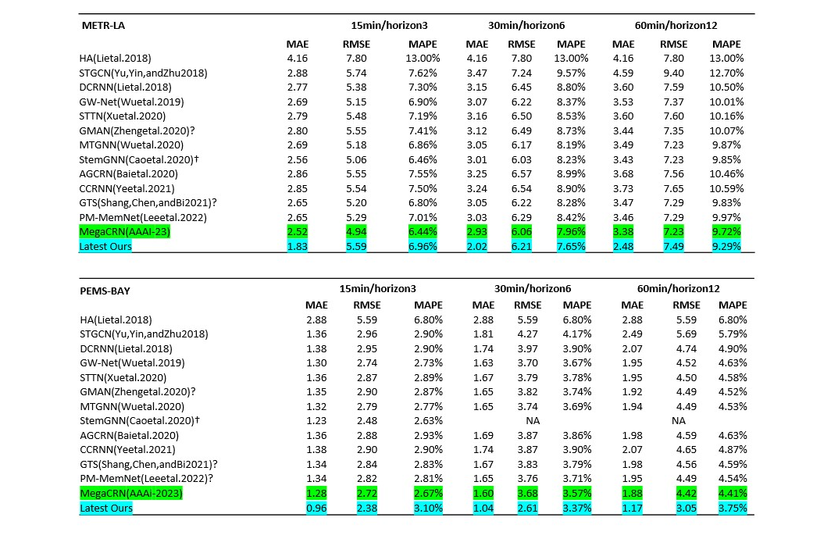
Model Performance Measurements

Slide 12
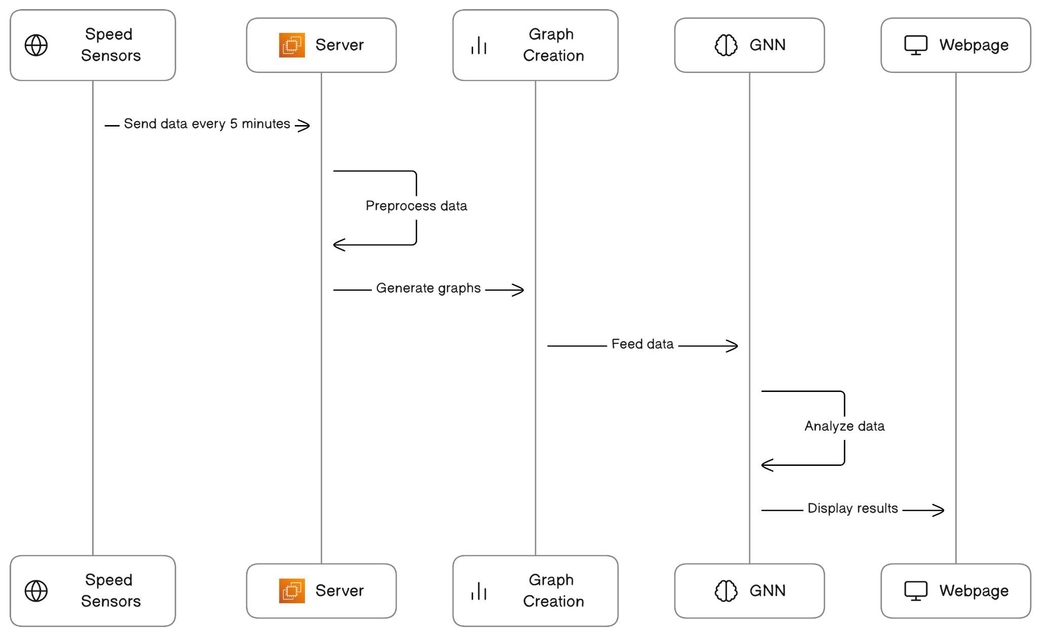
Real time Application Design

Slide 13
Roadmap - Expectations
Cross validation on
PEMS_D7M and EXPY-TKY
on [ 3, 5, 12] minutes of traffic forecasting
Evaluation(MAE,RMSE,MAPE)
Ablation study.

Slide 14
Outcome
A publication in either the AAAI (2024) or KDD (2024) conference.

